Slide 1

Mobile, Collaborative and
Context-Aware Systems
Laura Zavala, Radhika Dharurkar, Pramod Jagtap,
Tim Finin, Anupam Joshi and Amey Sane
University of Maryland, Baltimore County
AAAI Workshop on Activity Context Representation
07 August 2011
http://ebiquity.umbc.edu/p/539/

Slide 2

Agenda
Background, motivation and goals
General interaction architecture
Semantic context modeling
Privacy preservation
Context / situation recognition
Ongoing and future work
Conclusion

Slide 3

Platys Project
Part of an NSF collaborative project with NC state (M. Singh & I. Rhee) and Duke (R. Choudhury)
http://sites.google.com/site/platysproject/
Overall theme: enable smartphones to learn and exploit a richer notion of place
  Place is more than GPS coordinates
  Conceptual places include people, devices, activ-ities, purpose, roles, background knowledge, etc.
  Use this to provide better services and user experience

Slide 4
I am …
at (37.79414, -122.39597)
vs.
in a hotel, the Hyatt Regency SF, San Francisco, …
participating in a meeting, a workshop, the AAAI Activity Context Representation Workshop, …
with other >10 people including L. Shastri …
filling a speaker role
remembering I was here yesterday from 08:52 to 10:24 …
seeing many WIFI access point here: …
…

Slide 5
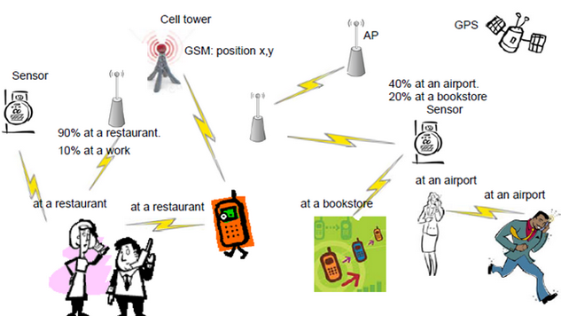
Sharing place information
Peer to peer communication
Opportunistic Gossiping
User privacy policies control sharing
Fixed devices acquire, store, share, and summarize
Notes:
Peer to peer communication among co-located nearby wireless devices based on opportunistic gossiping is used for sharing place information. Fixed devices such as sensors and access points (APs) can be used to reposit, share, and even summarize statistically the place information overheard from passing-by mobile devices.

Slide 6
Goals
Prototype and evaluate mobile context-aware applications for better services and user experiences
Use smartphones to capture and reason about context
Share context among devices
  Develop a semantic model of context
  Address privacy issues

Slide 7
Agenda
Background, motivation and goals
General interaction architecture
Semantic context modeling
Privacy preservation
Context / situation recognition
Ongoing and future work
Conclusion

Slide 8
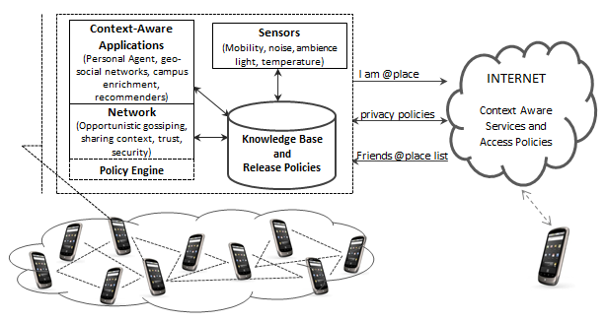
General Interaction Architecture
Device sensors used for contextual clues
Context RDF KB on each device
Context shared with neighboring devices
Devices interact directly or via Inter-net services
Privacy policies specify user’s infor-mation sharing constraints
Notes:
The Figure depicts a general interaction architecture for this type of systems. Sensors on devices are used to obtain clues about the local context of the user. We could use for example the user’s motion and mobility tracking and ambient conditions such as light and noise. The network component opportunistically gathers and disseminates local context information to neighboring fixed or mobile wireless devices. Its policy engine verifies the release policies to ensure release of information in accordance to the user preferences. Devices might interact directly or through services on the Internet. Inferences such as current activity can be drawn from the information collected by the sensors, the context information gathered, and additional resources (e.g., the user calendar and open geolocation KBs). The sensor’s raw data as well as the inferred context knowledge is stored in a local knowledge base on the device. Context-aware applications and network components may use this context knowledge to enhance their functionality. The locally inferred context knowledge can also be sent to context-aware services located on the Internet.

Slide 9
Current Work
Semantic model of context
  Grounded in explicit OWL ontologies
  Linked data integration: FOAF and GeoNames
  Local RDF KB +Jena on devices
Context / situation recognition
  Use sensors, status, settings, user data (e.g., calendar) and linked data (e.g., geonames) to recognize context
  Individual activity and conceptual place recognition
User privacy
  Privacy policies for sharing contextual information
  Prototype ad hoc sharing of context info

Slide 10
Agenda
Background, motivation and goals
General interaction architecture
Semantic context modeling
Privacy preservation
Context / situation recognition
Ongoing and future work
Conclusion

Slide 11
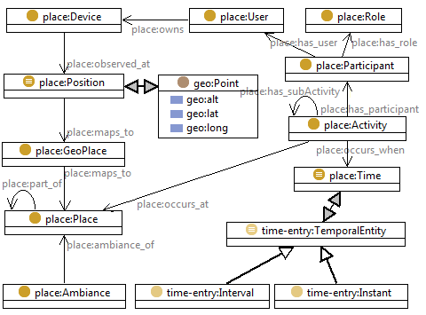
The Place ontology: semantic model of a person’s context
Light-weight, upper level context ontology
Centered around the concepts for
  Users
  Conceptual places
  Activities
  Roles
  Time
Conceptual places such as at work and at home
Activities occur at places and involve users filling particular roles
http://ebiquity.umbc.edu/ontologies/platys/1.0/

Slide 12
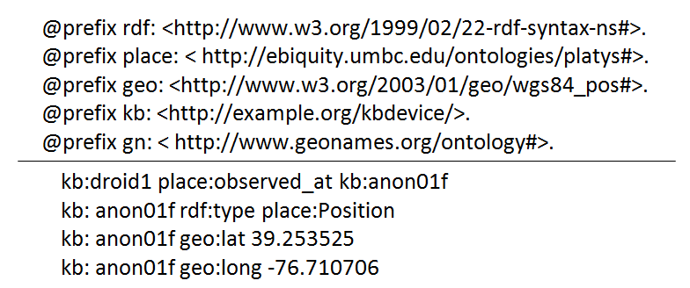
Context KB on the devices
A KB on the device which conforms to the ontology
Links to FOAF and GeoNames
Use of Geonames to assert further spatial knwledge in the KB
<gn:Feature rdf:about="http://sws.geonames.org/4372143/">
<gn:name>UMBC</gn:name>
<wgs84_pos:lat>39.25543</wgs84_pos:lat>
<wgs84_pos:long>-76.71168</wgs84_pos:long>
<wgs84_pos:alt>61</wgs84_pos:alt>
<gn:parentFeature rdf:resource="http://sws.geonames.org/4347790/"/> ←Baltimore County
<gn:parentCountry rdf:resource="http://sws.geonames.org/6252001/"/> ← United States
<gn:parentADM1 rdf:resource="http://sws.geonames.org/4361885/"/> ← Maryland
<gn:parentADM2 rdf:resource="http://sws.geonames.org/4347790/"/> ← Baltimore County
</gn:Feature>
Notes:
We use the Android Location API to obtain the position of the device. Position on Android phones is determined through location providers such as the device’s GPS and the network (which is based on availability of cell tower and WiFi access points). Given the Position of the user’s device, we assert the corresponding triples into the KB

Slide 13
Agenda
Background, motivation and goals
General interaction architecture
Semantic context modeling
Privacy preservation
Context / situation recognition
Ongoing and future work
Conclusion

Slide 14
Privacy Preservation
Privacy controls in existing location sharing applications
  “Friends Only” and “Invisible” restrictions are common
Need for high-level, flexible, expressive, declarative policies
    Temporal restriction, freshness, granularity, access model (e.g. optimistic or pessimistic)
    Context dependent release of information
    Obfuscation of shared information
Notes:
Temporal Restriction: Date and time interval restrictions for disclosing the context information.
Freshness: Specifies the freshness of the disclosed context information.
Timestamp: Specifies the time in which the privacy rule has been created.
AccessPolicy: Represents the access policy (Optimistic or Pessimistic) that this privacy rule is associated with.
high-level, declarative policies that describe users’ information sharing preferences under given contextual situations.
Besides being able to specify which information a user is willing to share, we can specify how that information
should be shared. A user can disclose information with different accuracy levels; for instance, she may be willing
to reveal to her close friends the exact room and building on which she is located, but only the vicinity or town to
others.

Slide 15
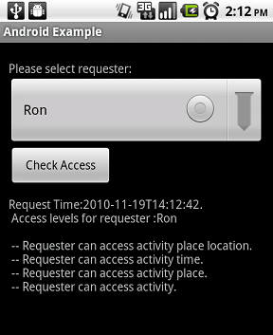
Privacy Policies
Requests come from other devices asking to share contextual information
  A specified protocol
  SPARQL queries
Rules using context model and KB on device
@prefix kb: <http://semantic-context.org/device#>.
@prefix rdf: <http://www.w3.org/1999/02/22-rdf-syntax-ns#>.
@prefix foaf: <http://xmlns.com/foaf/0.1/> .
[AllowFamilyRule:
(?requester kb:contextAccess kb:userPermitted)
<-
(?requester rdf:type kb:requester)
(?groupFamily foaf:member ?requester)
(?groupFamily foaf:name "Family")
]
  Share building-wide location with teachers on weekdays only between 9 am and 6 pm
  Share detailed context information with family members
  Do not share my context if I am in a date with girlfriend
  Share my room-wide location with everyone in the same building as me
Flexible privacy policies
  Role and group based context/location sharing
  Obfuscation of location nand activity information
  Summarization
Jena prototype on Android
Notes:
Current implementation of rules and ontology reasoning in Java using Jena
A prototype has been implemented by one of our students using Jena semantic Web framework on Android phones.
Requests are simple messages. Access rights are obtained by performing forward reasoning. Manual construction of answer. Ad-hoc location hierarchy provided for testing purposes.

Slide 16
Location Generalization
  Share my location with teachers on weekdays from 9am-5pm
    User’s exact location in terms of GPS co-ordinates is shared
    The user may not be interested to share GPS co-ordinates but fine with sharing city-level location
  Share my building-wide location with teachers on weekdays from 9am-5pm
Notes:
This approach has its own limitations as it doesn’t allow sharing on different granularity levels of the location. In many cases the user might be interested to share the location but not in terms of GPS coordinates.

Slide 17
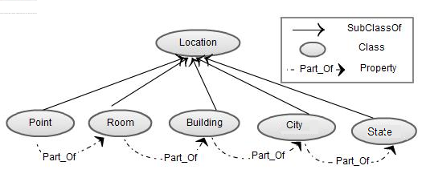
Location Generalization
  Hierarchical model of location to support location generalization
  The transitive Part_Of property creates the location hierarchy
  GeoNames spatial containment knowledge is also used when populating the KB

Slide 18
Activity Generalization
  Share my activity with friends on weekends
    User’s current activity shared w. friends on weekends
    Share more generalized activity rather that precise
    confidential project meeting => Working, Date => Meeting
  User clearly needs to obfuscate certain pieces of activity information to protect her context info
  Share my public activity with friends on weekends
    Public is a visibility option
Notes:
It will enable users to have default privacy policies based on different accuracy levels.

Slide 19
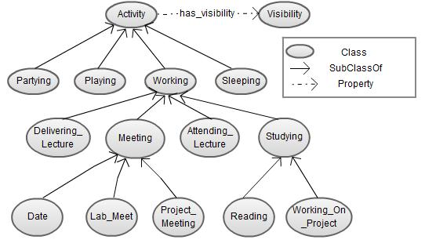
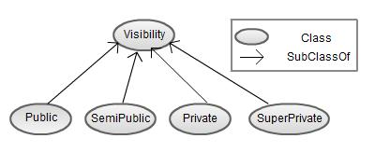
Activity Generalization

Slide 20
Agenda
Background, motivation and goals
General interaction architecture
Semantic context modeling
Privacy preservation
Context / situation recognition
Ongoing and future work
Conclusion

Slide 21
Context / situation recognition
Focus on individual activity and place recognition
Using smartphones as sensors we use probabilistic models for context recognition
  noise, ambience light, accelerometer, Wifi, Bluetooth, call stats, phone settings, user calendar
Data collection program used to collect training data to learn to recognize context
  5 users, 1 month, logging TRUE activity and place attached to phone readings (noise, light, etc.)
  Naive Bayes, decision tree, SVM, and bagging+decisiontrees

Slide 22
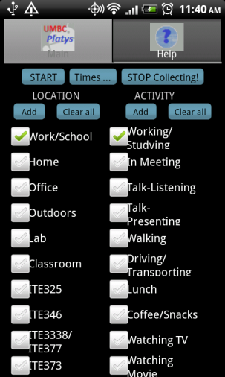
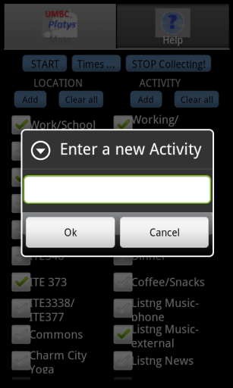
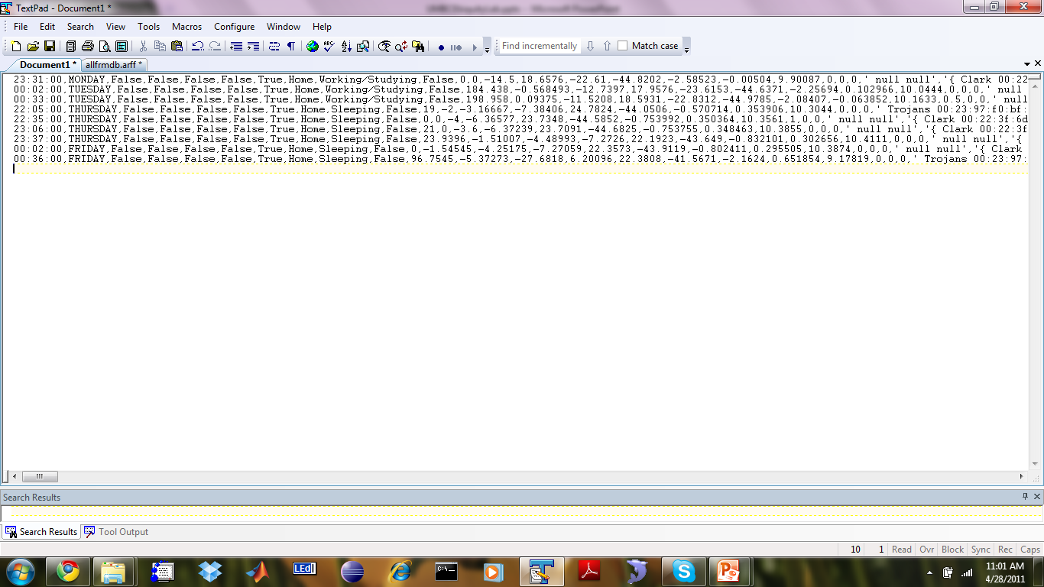
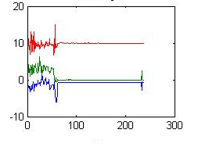
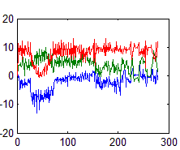
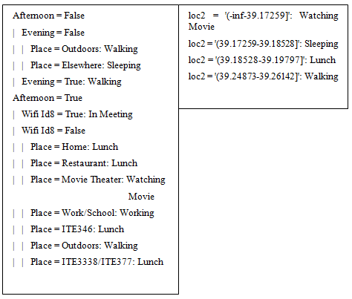
Context / situation recognition
(process overview)
Feature Vector
Time, Noise level in db (avg, min, max), accel 3 axis (avg, min, max, magnitude, wifis, …
Decision Trees
Naïve Bayes
SVM
Train Classifiers

Slide 23
Evaluation Experiments
Varying granularity level on activities
  Motion, Stationary
  Work, Home, Outdoors, Other
  In meeting, in class, watching TV, reading, sleeping, etc.
Two different schemes
  Individual: training and testing on one person’s data
  Across users: training with one person’s data and testing it with other’s

Slide 24
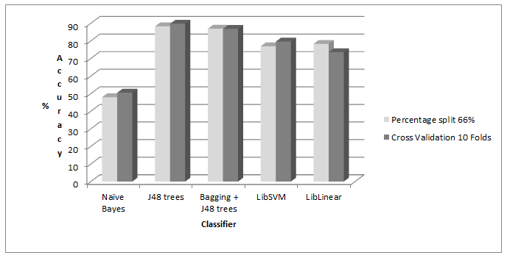
Results – Comparing classifiers
Accuracy higher for decision tree classifiers
  Improved with bagging
SVMs slightly below decision trees
Weak performance of Naive Bayes

Slide 25
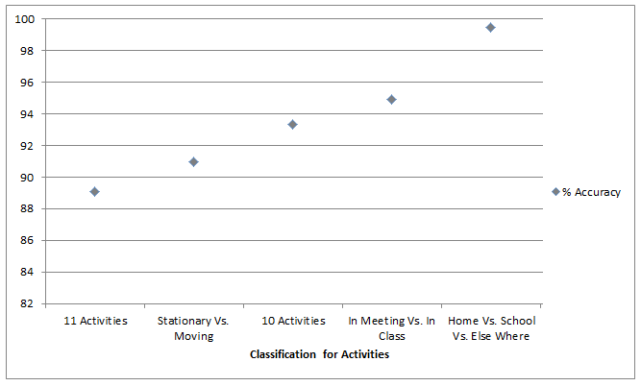
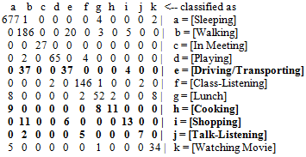
Results – Generalizing activities
Some states hard to distinguish
Fewer states => greater accuracy

Slide 26
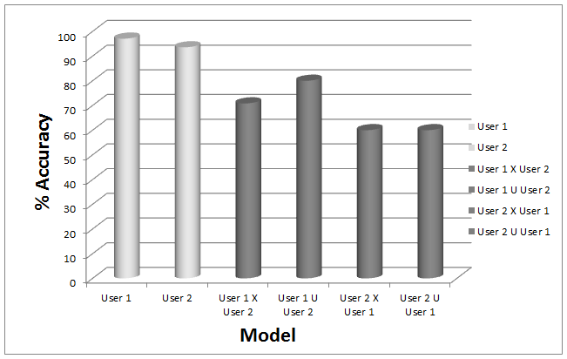
Results – Testing across users
Accuracy drops when using a general model or one not trained on a different user

Slide 27
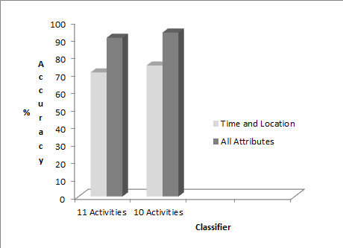
Results – Time and Location
Time and location attributes important, but adding more significantly improves accuracy

Slide 28
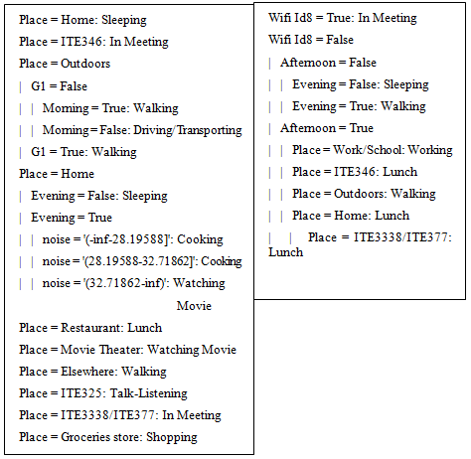
Results – Decision tree output model

Slide 29
Agenda
Background, motivation and goals
General interaction architecture
Semantic context modeling
Privacy preservation
Context / situation recognition
Ongoing and future work
Conclusion

Slide 30
Ongoing Work
Collecting more data
Running the model on the device
Use HMMs for state recognition
Incorporating common sense knowledge as priors
  A person has only one home
  A person has only one workplace
  A meal is usually not repeated during the day
  Sleeping usually occurs at night
  Students study frequently

Slide 31
HMM data for a user
 | Noise level
Working | 0.610 | 0.355 | 0.021 | 0.007 | 0.007
Chatting | 0.125 | 0.851 | 0.014 | 0.007 | 0.003
Playing | 0.000 | 0.833 | 0.167 | 0.000 | 0.000
Walking | 0.099 | 0.792 | 0.085 | 0.011 | 0.014
Driving | 0.000 | 0.956 | 0.015 | 0.029 | 0.000
Coffee | 0.570 | 0.397 | 0.020 | 0.000 | 0.013
Other | 0.250 | 0.750 | 0.000 | 0.000 | 0.000
Meeting | 1.000 | 0.000 | 0.000 | 0.000 | 0.000
Shopping | 0.000 | 0.920 | 0.000 | 0.080 | 0.000
Dinner | 0.333 | 0.667 | 0.000 | 0.000 | 0.000
Sleeping | 0.858 | 0.134 | 0.008 | 0.000 | 0.000
Lunch | 0.579 | 0.395 | 0.026 | 0.000 | 0.000
Watching TV | 0.092 | 0.862 | 0.031 | 0.015 | 0.000
Cooking | 0.119 | 0.786 | 0.071 | 0.024 | 0.000
On Call | 0.450 | 0.400 | 0.150 | 0.000 | 0.000
Movie | 0.000 | 1.000 | 0.000 | 0.000 | 0.000
Class | 0.000 | 1.000 | 0.000 | 0.000 | 0.000
Conversation | 0.250 | 0.750 | 0.000 | 0.000 | 0.000
Exercising | 0.000 | 1.000 | 0.000 | 0.000 | 0.000
Reading | 0.000 | 0.714 | 0.286 | 0.000 | 0.000
Cleaning | 1.000 | 0.000 | 0.000 | 0.000 | 0.000
87% | 1% | 0% | 7% | 0% | 0% | 0% | 0% | 0% | 0% | 1% | 0% | 1% | 0% | 0% | 0% | 0% | 0% | 0% | 0% | 0%
1% | 91% | 0% | 4% | 0% | 0% | 0% | 0% | 0% | 0% | 3% | 0% | 0% | 0% | 0% | 0% | 0% | 0% | 0% | 0% | 0%
17% | 0% | 67% | 17% | 0% | 0% | 0% | 0% | 0% | 0% | 0% | 0% | 0% | 0% | 0% | 0% | 0% | 0% | 0% | 0% | 0%
10% | 5% | 0% | 64% | 11% | 2% | 1% | 0% | 1% | 0% | 1% | 1% | 0% | 0% | 1% | 0% | 0% | 0% | 1% | 0% | 0%
3% | 0% | 0% | 41% | 49% | 1% | 0% | 0% | 3% | 1% | 0% | 1% | 0% | 0% | 0% | 0% | 0% | 0% | 0% | 0% | 0%
15% | 1% | 0% | 3% | 0% | 81% | 0% | 0% | 0% | 0% | 0% | 0% | 1% | 0% | 0% | 0% | 0% | 0% | 0% | 0% | 0%
25% | 0% | 0% | 0% | 0% | 0% | 50% | 0% | 0% | 0% | 0% | 0% | 0% | 0% | 0% | 0% | 25% | 0% | 0% | 0% | 0%
50% | 0% | 0% | 0% | 0% | 0% | 0% | 50% | 0% | 0% | 0% | 0% | 0% | 0% | 0% | 0% | 0% | 0% | 0% | 0% | 0%
4% | 0% | 0% | 16% | 4% | 0% | 0% | 0% | 72% | 0% | 0% | 0% | 0% | 4% | 0% | 0% | 0% | 0% | 0% | 0% | 0%
7% | 0% | 0% | 13% | 0% | 0% | 0% | 0% | 0% | 73% | 0% | 0% | 0% | 0% | 7% | 0% | 0% | 0% | 0% | 0% | 0%
0% | 1% | 0% | 0% | 0% | 5% | 0% | 0% | 0% | 0% | 94% | 0% | 0% | 0% | 0% | 0% | 0% | 0% | 0% | 0% | 0%
13% | 0% | 0% | 5% | 0% | 0% | 0% | 0% | 0% | 0% | 0% | 82% | 0% | 0% | 0% | 0% | 0% | 0% | 0% | 0% | 0%
2% | 0% | 0% | 3% | 0% | 0% | 0% | 0% | 0% | 0% | 6% | 0% | 89% | 0% | 0% | 0% | 0% | 0% | 0% | 0% | 0%
5% | 0% | 0% | 2% | 0% | 0% | 0% | 0% | 0% | 0% | 0% | 0% | 2% | 90% | 0% | 0% | 0% | 0% | 0% | 0% | 0%
15% | 0% | 0% | 0% | 0% | 0% | 0% | 0% | 0% | 0% | 0% | 0% | 0% | 5% | 80% | 0% | 0% | 0% | 0% | 0% | 0%
0% | 0% | 0% | 17% | 0% | 0% | 0% | 0% | 0% | 0% | 0% | 0% | 0% | 0% | 0% | 83% | 0% | 0% | 0% | 0% | 0%
0% | 0% | 0% | 0% | 0% | 0% | 0% | 0% | 0% | 0% | 0% | 0% | 0% | 0% | 0% | 0% | 0% | 100% | 0% | 0% | 0%
25% | 0% | 0% | 0% | 0% | 0% | 0% | 0% | 0% | 0% | 0% | 0% | 0% | 0% | 0% | 0% | 0% | 75% | 0% | 0% | 0%
0% | 3% | 0% | 8% | 0% | 0% | 0% | 0% | 0% | 0% | 0% | 0% | 0% | 0% | 0% | 0% | 0% | 0% | 89% | 0% | 0%
14% | 0% | 0% | 0% | 0% | 0% | 0% | 0% | 0% | 0% | 0% | 0% | 0% | 0% | 0% | 0% | 0% | 0% | 0% | 86% | 0%
0% | 0% | 0% | 0% | 0% | 0% | 0% | 0% | 0% | 33% | 0% | 0% | 0% | 0% | 0% | 0% | 0% | 0% | 0% | 0% | 67%
State transition probability data
Emission probabilities

Slide 32
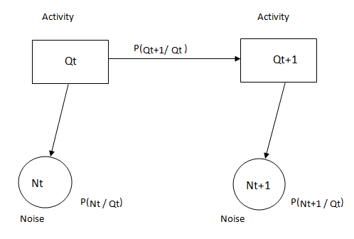
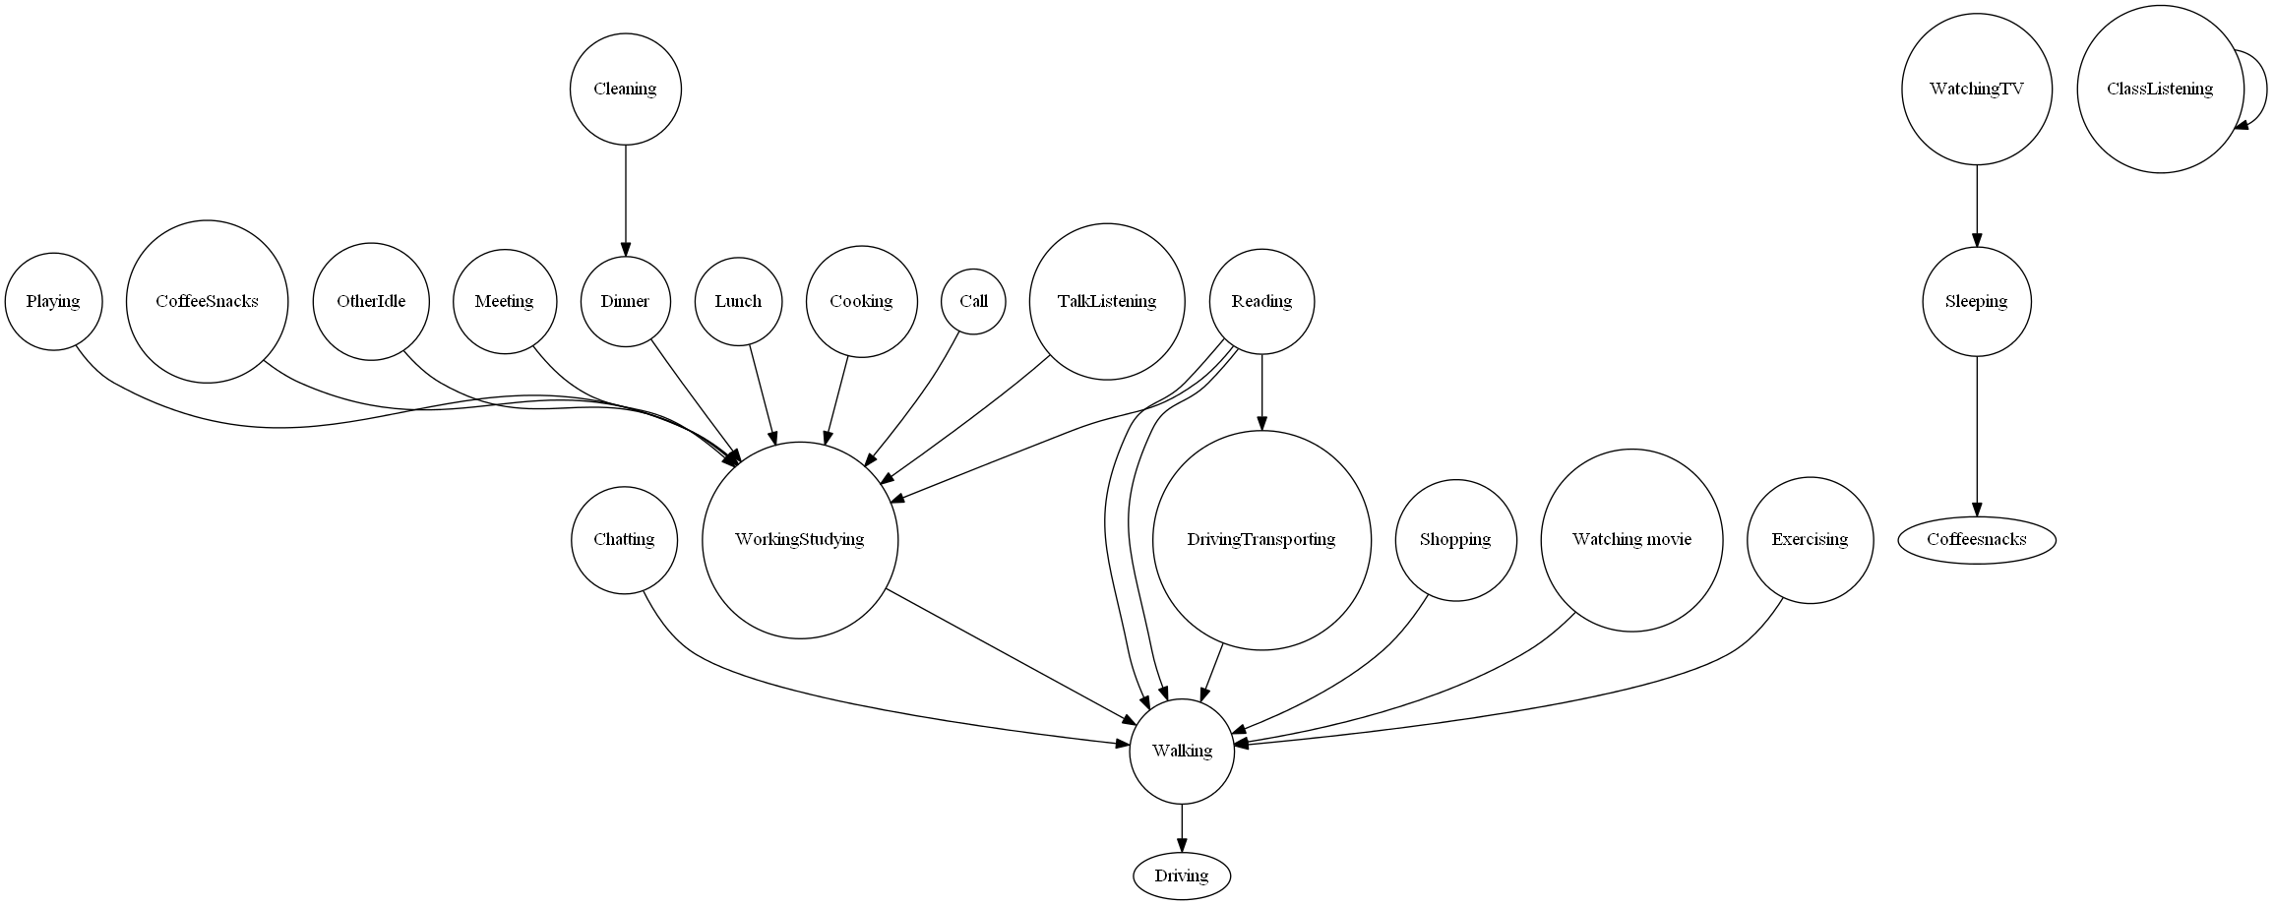
HMM representation
Activities are the states and sensor readings
such as noise and accelerometer data are
the observations
A partial state transition graph with the most likely non-loop transition for each state

Slide 33
Future Work
Policy language for policy declaration and enforcement integration
  Richer policies at the triple level
  Protect the inferences that can be drawn from the information that is shared
  A mix of rich pattern matching such as SPARQL and rules, with First Order semantics

Slide 34
Depending on the kindness of strangers
People are cooperative and ask one another for information
  Stanger on the street: Does this bus go to the aquarium?
  Random classmate: When is HW6 due?
Devices can use ad hoc networks (e.g., Bluetooth) to query nearby devices for desired information
Each device has an info. sharing policy for what triples can be used to answer the query based on context and requester’s information
➔ Mobile Ad Hoc Knowledge Network

Slide 35
Agenda
Background, motivation and goals
General interaction architecture
Semantic context modeling
Privacy preservation
Context / situation recognition
Ongoing and future work
Conclusion

Slide 36
Conclusion
We established our baseline system for simple activity recognition in a university environment
Our description logic representation enables
  Inferences and rules
  An expressive query language (SPARQL)
  More expressive policy languages for information sharing and privacy
  A natural way to give less general responses to queries

