Slide 1

Clustering short status messages:
A topic model based approach
Masters Thesis Defense
Anand Karandikar
Advisor: Dr. Tim Finin
Date: 26th July 2010
Time: 9:00 am
Place: ITE 325B
http://www.binterest.com/

Slide 2

Thesis Contributions
Determine a topic model that is “optimal” for clustering tweets by determining good parameters to build a topic model in terms of dataset type, dataset size and number of topics.
Cluster tweets based on topic similarity.
Cluster twitter users using topic models.

Slide 3
Outline
Introduction
Motivation
Related work
Approach
Experiments and results
Conclusion
Future work

Slide 4
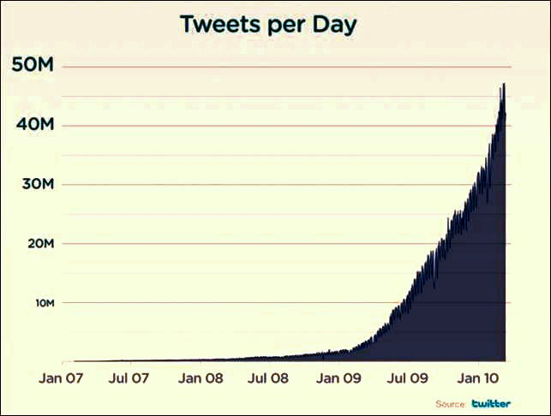
Rise of online social media
Ability to rapidly disseminate information. A medium of communication and information sharing.
Twitter, Facebook, Flickr and Youtube facilitate information sharing via text, hyperlinks, photos, video etc.
Status updates or tweets (for Twitter) can contain text, emoticon, link or their combination.

Slide 5
Basics…
Topic models are generative models.
The basic idea is to describe a document as mixture of different topics.
A topic is simply a collection of words that occur frequently with each other.
Properties of interest
Bag of words model, unsupervised learning, identify latent relationships in the data, document represented as a numerical vector

Slide 6
Motivation
Content oriented analysis applying NLP techniques is difficult
  Short length of messages, about 140 characters
  Lack of grammar rules. Use of abbreviations and slangs
  Implied references to entities
Topic models can address above mentioned difficulties.
Clustering will help research community to categorize tweets based on their content without the need for labeled data.
Such clustering will further help users to discover other users who post about topics of their liking or interest.

Slide 7
Related Work
Discover topics covered by papers in PNAS.
These were used to identify relationships between various science disciplines and finding latest trends.
Author-topic models
To discover topic trends, finding authors who most likely tend to write on certain topics.
Detect topics in biomedical text.
It performs topic based clustering using unsupervised hierarchical clustering algorithms.

Slide 8
Related Work
Smarter BlogRoll augments a blogroll with information about current topics of the blogs in that blog roll.
Map content in Twitter feed into dimensions that correspond roughly to substance, style, status and social characteristics of posts.
Identify latent patterns like informational and emotional messages in Earthquake and Tsunami data sets collected from Twitter.
Notes:
Oprah Winfrey was more about style
Wc was more about substance

Slide 9
Problem 1
Topic models can be trained using different datasets, varying size of training data and varying number of topics.
Problem Definition:
Given that we have topic models with varying parameters, to determine which topic model configuration is “optimal” for clustering tweets.

Slide 10
Problem 2
Problem Definition:
Given a set of twitter users and their tweets, cluster the twitter users based on similarity in the content they tweet about.

Slide 11
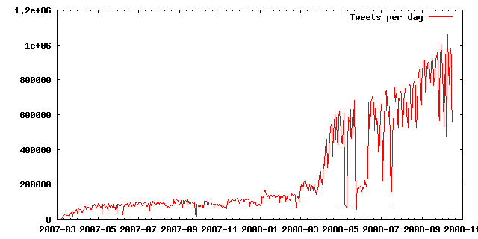
Twitterdb dataset
The total collection is about 150 million tweets from 1.5 million users, collected over a period of 20 months (during 2007–2008)
Language | Percentage
English | 32.4 %
Scots | 12.5 %
Japanese | 7.4 %
Catalan | 5.2 %
German | 3.9 %
Danish | 3.1 %
Approx. 48 million English tweets that can be used

Slide 12
TAC KBP Corpus
This was basically 2009 TAC KBP corpus with approximately 377K newswire articles from Agence France-Presse (AFP)
About half articles were from 2007 and half from 2008 with a few (less than 1%) from 1994-2006.
Disaster Events dataset
Event Name | Source
DC snow | Twitter API
NE thunderstorm | Twitter API
Haiti earthquake | Twitter API
Afghanistan war | Twitter API
China mine blasts | Twitter API
Gulf oil spills | Twitter API
California fires | Twitterdb
Gustav hurricane | Twitterdb
1500 tweets per event
Hence a total of 12k tweets

Slide 13
Supplementary test dataset
Event Name | Source | # tweets
Hurricane Alex | Twitter API | 624
China earthquake | Twitterdb | 376
Manually scanned through all 1000 tweets to make sure they are relevant to the respective event.
Sample Twitter API queries
Using words, hashtags and date ranges for querying
Haiti earthquake in Jan 2010: haiti earthquake # haiti since:2010-01-12 until:2010-01-16
Using words, date ranges and location
Washington DC snow blizzard in Feb 2010: snow since:2010-02-25 until:2010-02-28 near:”Washington DC” within:25mi
An eyeballing resulted in approximately 97% tweets obtained this way relevant to the event name in our Disaster events dataset.

Slide 14
Approach
Disaster Events data with 12000 tweets
Training Corpus
MALLET
topic modeler
12000 topic vectors
Topic inference file
Clustering
Output
Topic model configuration parameters

Slide 15

Topic modeler
http://mallet.cs.umass.edu/
Why MALLET?
  open source.
  extremely fast and highly scalable implementation of Gibbs sampling.
  tools to infer topics from new documents.
Steps involved in building a topic model
Input
Training
‘train-topics’ command
200 to 400 topics for fine granularity
Output
Inference file
Top ‘k’ words associated with each topic
Pruning of dataset
Convert input data to MALLET’s internal data format

Slide 16
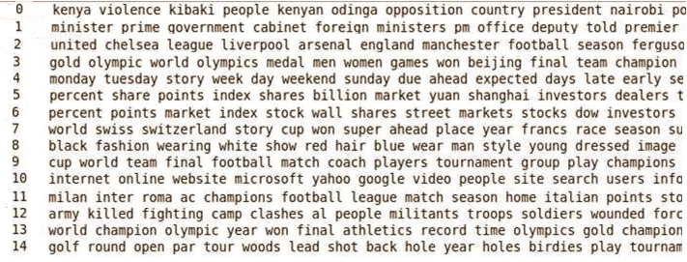
Topic to word association

Slide 17

Topic model configurations
Training corpus | Size of training corpus | # topics
Twitterdb | 5, 10, 15, 16, 17, 18, 19, 20, 40 (in millions) | 200, 300, 400
TAC KBP | Approx 377k documents | 200, 300, 400
Topic vectors
Using previously generated inference file.
The output is a topic vector which gives a distribution over each topic for
every document.

Slide 18
Clustering
A common way to visualize N-dimensional data by exploring similarities and dissimilarities in it.
cmdscale command in R.
Input: Distance matrix which indicates dissimilarities in the row vectors
Output: set of points s.t. distance between them is proportional to the dissimilarities in them.
Aims to partition n observations into k clusters in which each observation belongs to the cluster with the nearest mean.
k-means command in R
Input: output from MDS
Output: data points associated with cluster-id’s
Cluster 1
Cluster 5
Cluster 4
Cluster 2
Cluster 3
MDS
K-means clustering
Topic vectors
CSV Format
R analysis package
Widely used for statistical computing and visualizations of large datasets.
Built-in functions and rich data structures.
Open source.
Induced clusters
Notes:
http://stat.ethz.ch/R-manual/R-patched/library/stats/html/cmdscale.html
http://stat.ethz.ch/R-manual/R-patched/library/stats/html/dist.html
http://en.wikipedia.org/wiki/Multidimensional_scaling
http://en.wikipedia.org/wiki/K-means_clustering
http://stat.ethz.ch/R-manual/R-patched/library/stats/html/kmeans.html

Slide 19
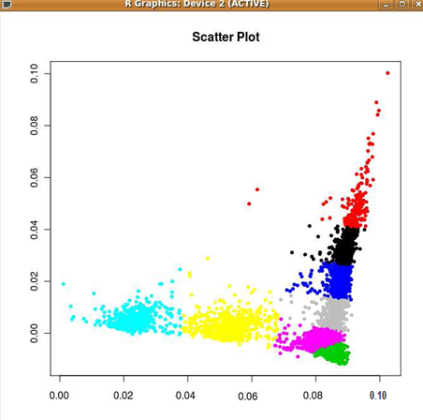
Sample 2-D clustering output via R
Clustering with k = 8 on disaster events dataset using topic model trained on TAC KBP news wire corpus with # topics=200

Slide 20
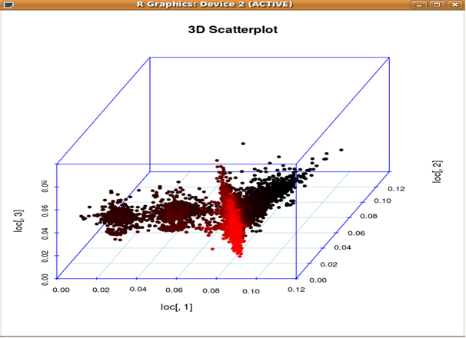
Sample 3-D plot
Clustering with k = 8 on disaster events dataset using topic model trained on TAC KBP news wire corpus with # topics=200

Slide 21
Evaluation
8 original clusters over 12k tweets with 1500 tweets per cluster
Induced Clusters over the same 12k tweets using K-means
Previously trained topic model
12000 topic vectors
MDS and k-means

Slide 22
Evaluation Parameters
Clustering parameters
Residual Sum of Squares (RSS)
Cluster cardinality
Cluster centers and iterations for convergence
Cluster validations – cardinality and goodness
Clustering accuracy
Topic model parameters
Training corpus size
Training corpus type – news wire and twitterdb
Number of topics

Slide 23
Residual Sum of Squares (RSS)
RSS is the squared distance of each vector from it’s cluster centroid summed
over all vectors in the cluster.
RSS_{k} = ∑_{xωk} |x − μ(ω_{k})|²
where μ(ω_{k}) represents centriod of cluster ω_{k} given by
μ(ω_{k}) = (1/|ω|)∑ _{xω} x
Hence, the RSS for a particular clustering output with say K clusters is given by
RSS = ∑ ^{K} _{k=1} RSS_{k}
Smaller value of RSS indicates tighter clusters.

Slide 24
Cluster Cardinality
Heuristic method to calculate number of clusters for k-means
clustering algorithm as mentioned in [1]
Perform clustering i times(we use i = 10) for a said value of k. Find the RSS in each case.
Find the minimum RSS value. Denote it as RSS_{min}.
Find RSS_{min} for different values of k as k increases.
Find the ’knee’ in the curve i.e. the point where successive decrease in this value is the smallest. This value of k indicates the cluster cardinality.
[1] Manning, Christopher, D.; Raghavan, P.; and Schutze, H. 2008. Introduction to
Information Retrieval. Cambridge University Press.

Slide 25
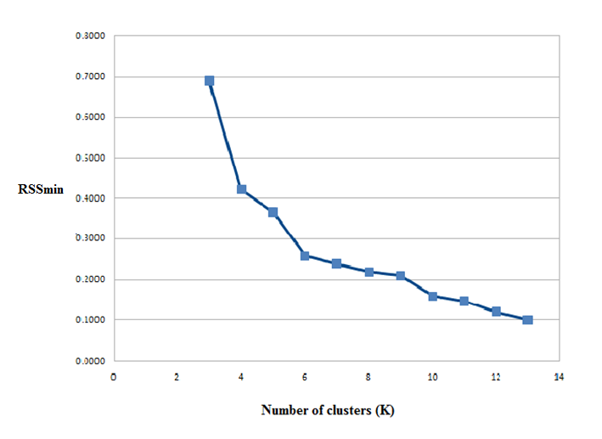
RSS_{min} versus k
RSS_{min} | k
0.6903 | 3
0.4220 | 4
0.3662 | 5
0.2581 | 6
0.2391 | 7
0.2192 | 8
0.2098 | 9
0.1594 | 10
0.1469 | 11
0.1204 | 12
0.0999 | 13
RSS_{min} and k for twitterdb trained topic model with 200 topics

Slide 26
Cluster centers and iterations
K-means in R-analysis package randomly chooses data rows as cluster centers.
The default number of iterations performed until convergence is reached is 10.
We have built more than 27 different topic models and performed k-means clustering for each. We have observed that baring just 3 cases convergence was reached within 10 iterations.
In those 3 cases, convergence was achieved by setting the # iterations to 15.
Notes:
Convergence – when assignments no longer change
k random centers,
assign data points to the nearest cluster center
Calculate new centroid as mean
repeats steps 2 and 4 until convergence is reached…

Slide 27

Cluster validations
Cluster cardinality using RSS_{min} versus k
Goodness of clustering itself using Jaccard coefficient
Jaccard coefficient
Higher the Jaccard coefficient value, more is an
induced cluster similar to an original cluster

Slide 28
Effect of change in training data size on Jaccard coefficient
Case # | Training size (tweets in millions)
1 | 5
2 | 10
3 | 16
4 | 17
5 | 18
6 | 19
7 | 20
8 | 40
#topics = 200, twitterdb training data
Similar results obtained for topic models with #topics=300

Slide 29
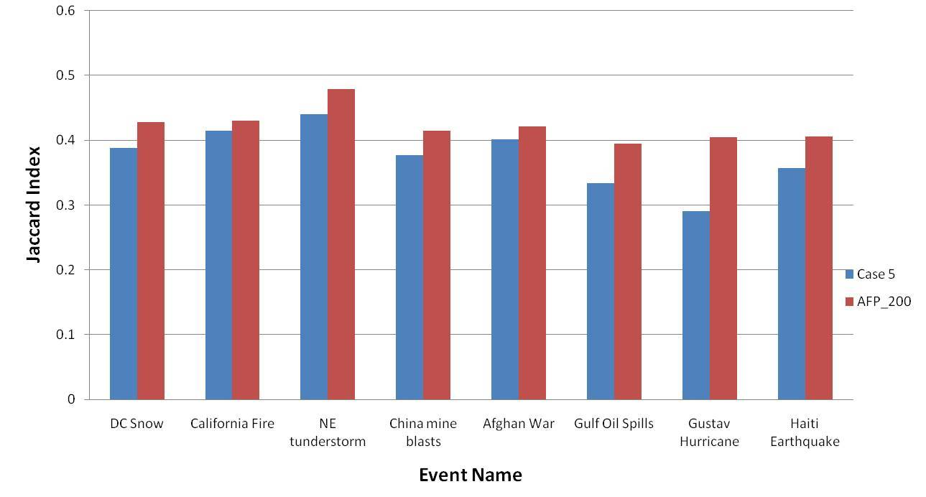
Effect of change in training data type on Jaccard coefficient
#topics=200, we compare the best model from previous slide with news wire trained model.

Slide 30
Effect of change in # topics on Jaccard coefficient
All models trained with same 16 million tweets from twitterdb

Slide 31
Selecting an optimal topic model
# topics 300
TAC KBP corpus for trained model outperforms twitterdb trained models
TAC KBP trained topic model with 300 topics is the optimal one.

Slide 32
Jaccard coefficient matrix
 | DC snow | California fire | NE thunderstorm | China mine blasts | Afghan war | Gulf Oil Spills | Gustav hurricane | Haiti Earthquake
DC snow | 0.505 | 0.028 | 0.231 | 0.016 | 0.009 | 0.046 | 0.12 | 0.048
California fire | 0.024 | 0.483 | 0.042 | 0.127 | 0.139 | 0.08 | 0.046 | 0.061
NE thunderstorm | 0.141 | 0.012 | 0.498 | 0.004 | 0.016 | 0.111 | 0.213 | 0.009
China mine blasts | 0.008 | 0.092 | 0.016 | 0.546 | 0.21 | 0.024 | 0.003 | 0.101
Afghan war | 0.019 | 0.136 | 0.026 | 0.124 | 0.49 | 0.016 | 0.097 | 0.098
Gulf Oil Spills | 0.089 | 0.071 | 0.009 | 0.066 | 0.117 | 0.527 | 0.018 | 0.083
Gustav hurricane | 0.178 | 0.061 | 0.18 | 0.037 | 0.002 | 0.096 | 0.492 | 0.101
Haiti Earthquake | 0.051 | 0.134 | 0.003 | 0.108 | 0.09 | 0.101 | 0.014 | 0.499
Original
Induced

Slide 33
Observations based on Jaccard coefficient matrix
Induced Cluster | Top 5 most frequent words from event datasets
Afghan war | war, fires, army, terrorist, kill
California fire | fire, burn, smoke, damage, west
NE thunderstorm | storm, winds, rain, warning, people
Gustav hurricane | hurricane, storm, floods, heavy, weather
Topic keys generated by MALLET
fire, california, fires, damage, police, killed, shot, attack, died, injured, wounded
storm, people, hurricane, rain, rains, flood, flooding, coast, mexico, areas

Slide 34
Accuracy on test data
Cluster Name | Size of induced cluster (A) | Correctly clustered tweets (A  B) | Original cluster size (B) | Jaccard coefficient | Accuracy
Hurricane Alex | 572 | 403 | 624 | 0.508 | 64.58 %
China earthquake | 428 | 263 | 376 | 0.486 | 69.94 %
Baseline for comparison
A framework to classify short and sparse text by Phan, X. H.; Nguyen, L., M.; and Horiguchi, S. 2008.
Accuracy of around 67% using 22.5k documents for training and with 200 topics using topic models with Gibbs sampling.

Slide 35
Clustering twitter users
21 well known twitter users across 7 different domains
100 tweets per user via Twitter API
Domain | Twitter users
Sports | @ESPN, @Lakers, @NBA
Travel Reviews | @Frommers, @TravBuddy, @mytravelguide
Finance | @CBOE, @CNNMoney, @nysemoneysense
Movies | @imdb, @peoplemag, @RottenTomatoes, @eonline
Technology News | @Techcrunch, @digg_technews
Gaming | @EASPORTS, @IGN, @NeedforSpeed
Breaking News | @foxnews, @msnbc, @abcnews
Users were obtained via http://www.twellow.com/
It’s like yellow pages for twitter.

Slide 36
Results for twitter user clustering
Cluster # | Twitter users
1 | @CBOE, @msnbc, @CNNMoney, @nysemoneysense
2 | @IGN, @NeedforSpeed
3 | @EASPORTS, @ESPN, @Lakers, @NBA
4 | @Frommers, @TravBuddy, @mytravelguide
5 | @imdb, @peoplemag, @RottenTomatoes, @eonline
6 | @foxnews, @abcnews, @TechCrunch, @digg_technews

Slide 37
Conclusions
We have empirically shown how to select a topic model by considering various topic model and clustering parameters. We have also supplied statistical evidence for same.
We showed that a news wire trained topic model performs better than a twitterdb trained topic model for clustering tweets.
We obtained approx 65% accuracy for clustering tweets in the test dataset.
We also showed the usefulness of topic models to cluster twitter users.

Slide 38
Future Work
Using a faster implementation for k-means
How can we make the implementation scalable to cluster tweets at real time?
Extending the work to cluster Facebook status messages.

Slide 39
References
[1] Java, A.; Song, X.; Finin, T.; and Tseng, B. 2007. Why we twitter: Understanding micro blogging usage and communities. WebKDD/SNA-KDD 2007.
[2] Kireyev, K.; Palen, L.; and Anderson, A. 2009. Applications of topics models to analysis of disaster-related twitter data. NIPS Workshop 2009.
[3] Kuropka, D., and Becker, J. 2003. Topic-based vector space model.
[4] Lee, M.; Wang, W.; and Yu, H. Exploring supervised and unsupervised methods to detect topics in biomedical text.
[5] MacQueen, J., B. 1967. Some methods for classification and analysis of multivariate observations. In roceedings of 5th Berkeley Symposium on Mathematical Statistics and Probability. University of California Press., 281–297.
[6] Manning, Christopher, D.; Raghavan, P.; and Schutze, H. 2008. Introduction to Information Retrieval. Cambridge University Press.
[7] McCallum, A.; Corrada-Emmanuel, A.; and Wang, X. Topic and role discovery in social networks.
[8] McCallum, A. K. 2002. Mallet: A machine learning for language toolkit.
[9] Murnane, W. 2010. Improving accuracy of named entity recognition on social media data. Master’s thesis, University of Maryland, Baltimore County.
[10] Phan, X. H.; Nguyen, L., M.; and Horiguchi, S. 2008. Learning to classify short and sparse text & web with hidden topics from large-scale data collections. In Proceedings of the 17th International World Wide Web Conference (WWW 2008), 91–100.

Slide 40
References
[11] R Development Core Team. 2010. R: A Language and Environment for Statistical Computing. R Foundation for Statistical Computing, Vienna, Austria. ISBN 3-900051-07-0.
[12] Ramage, D.; Dumais, S.; and Liebling, D. Characterizing microblogs with topic models. In Proceedings of the Fourth International AAAI Conference on Weblogs and Social Media.
[13] Starbird, K.; Palen, L.; Hughes, A.; and Vieweg, S. 2010. Chatter on the red:what hazards threat reveals about the social life of microblogged information. ACM CSCW 2010.
[14] Steyver, M., and Griffiths, T. 2007. Probabilistic Topic Models. Lawrence Erlbaum Associates.
[15] Steyvers, M.; Griffiths, T., H.; and Smyth, P. 2004. Probabilistic author-topic models for information discovery. In Proceedings in 10th ACM SigKDD conference knowledge discovery and data mining.
[16] Vieweg, S.; Hughes, A.; Starbird, K.; and Palen, L. 2010. Supporting situational awareness in emergencies using microblogged information. ACM Conf. on Human Factors in Computing Systems 2010.
[17] Yardi, S.; Romero, D.; Schoenebeck, G.; and Boyd, D. 2010. Detecting spam in a twitter network. First Monday 15:1–4.
[18] Zhao, D., and Rosson, M. B. 2009. How and why people twitter: the role that microblogging
plays in informal communication at work.

Slide 41
Questions?
Thank you!
Acknowledgements
Advisor, committee members and eBiquity members.

